Slide 1
Result Test APK IR Mobile Garudastore
23 FEBRUARI 2022
(FAMILY MART, alfamart & indomaret)

Slide 2
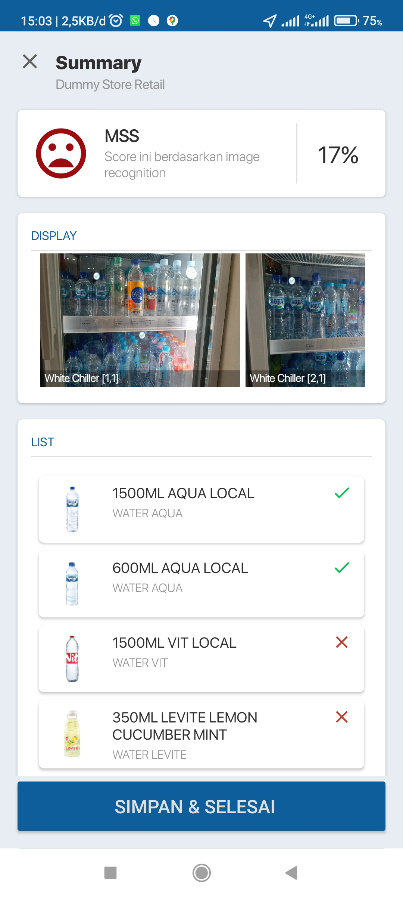
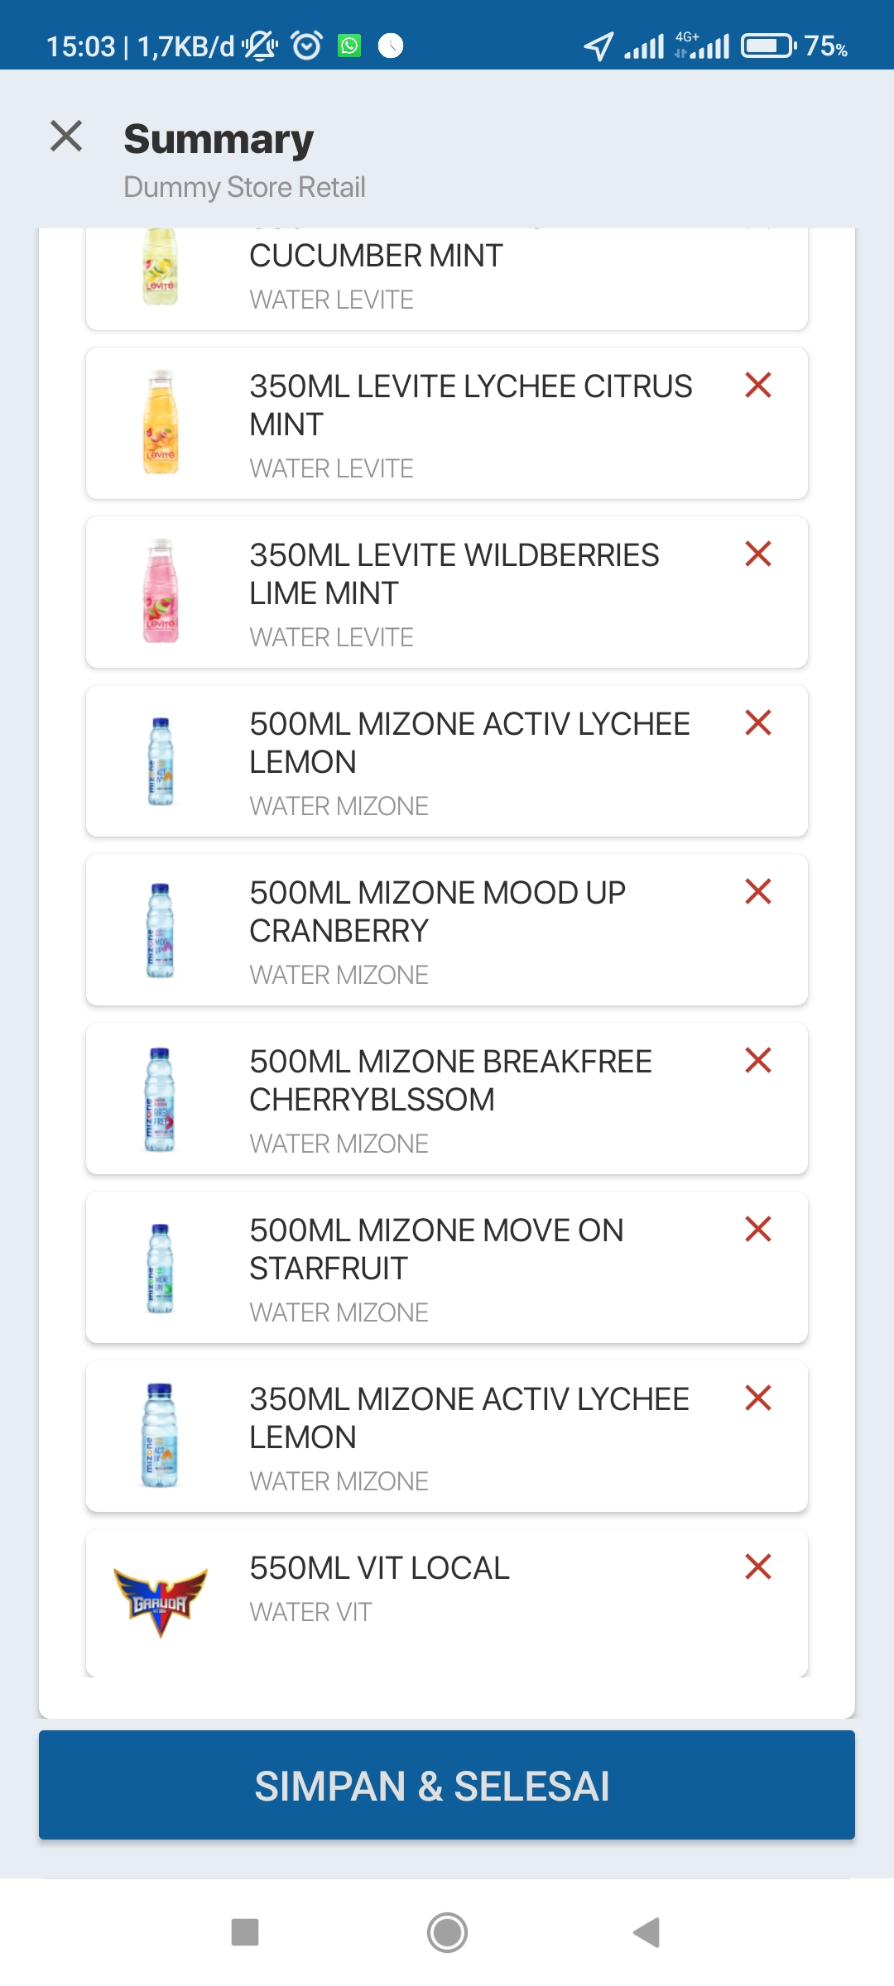
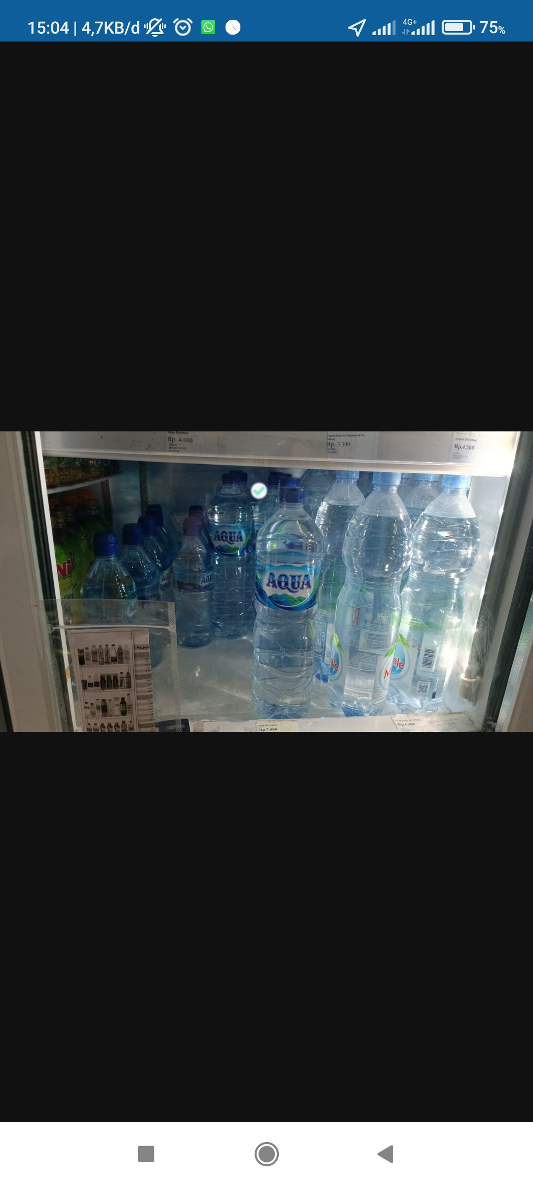
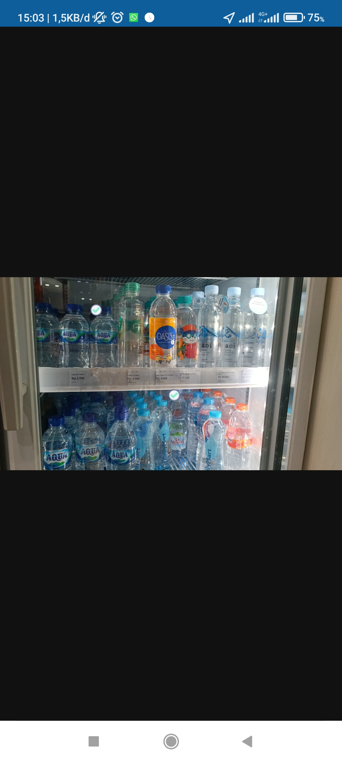
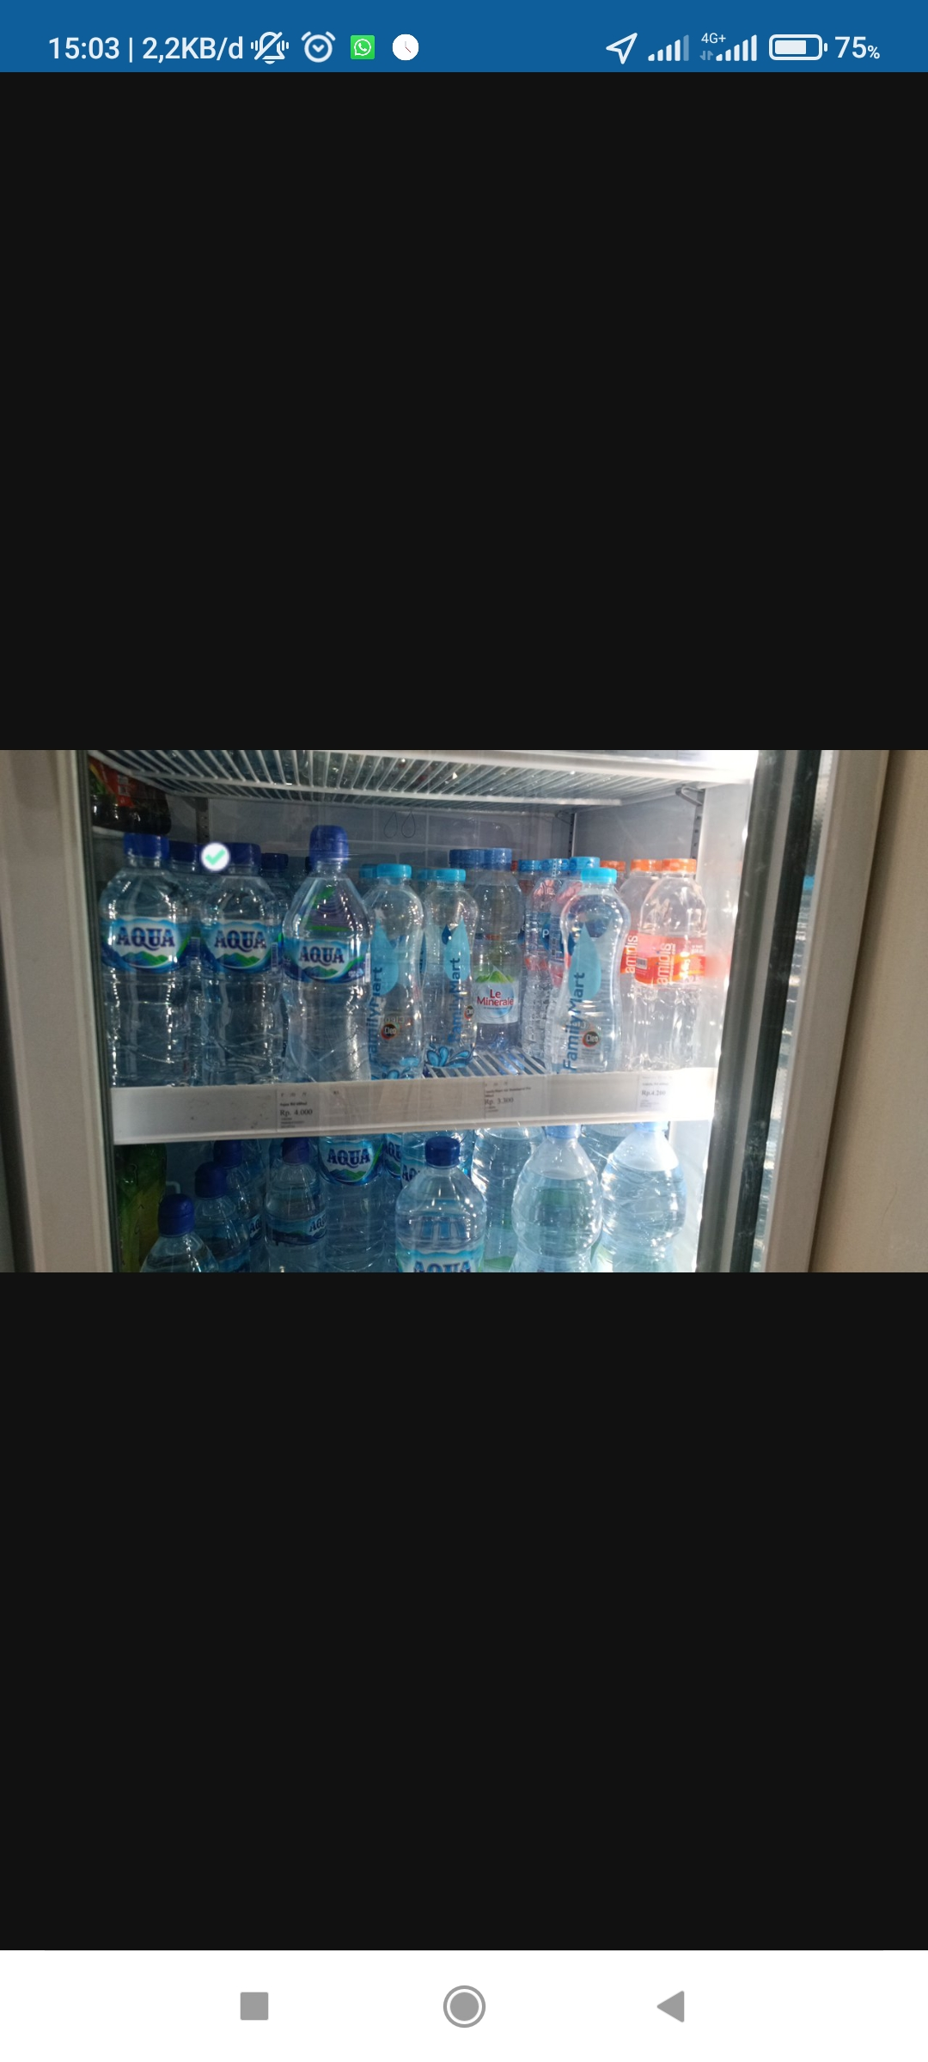
Dummy Store (Familymart) – Following Standard (Chiller)
RESULT :
1500ML AQUA LOCAL (product detected)
600ML AQUA LOCAL (detected)
1500ML VIT LOCAL (actual oos)
350ML LEVITE LEMON CUCUMBER MINT (actual oos)
350ML LEVITE LYCHEE CITRUS MITN (actual oos)
350ML LEVITE WILDBERRIES MINT (actual oos)
500ML MIZONE ACTIV LYCHEE LEMON (actual oos)
500ML MIZONE ACTIV MOOD UP CRANBERRY (actual oos)
500ML MIZONE ACTIV BREAKFREE CHERRYBLOSSOM (actual oos)
500ML MIZONE ACTIV MOVE ON STARFRUIT (actual oos)
350ML MIZONE ACTIV LYCHEE LEMON (actual oos)
550ML VIT LOCAL

Slide 3
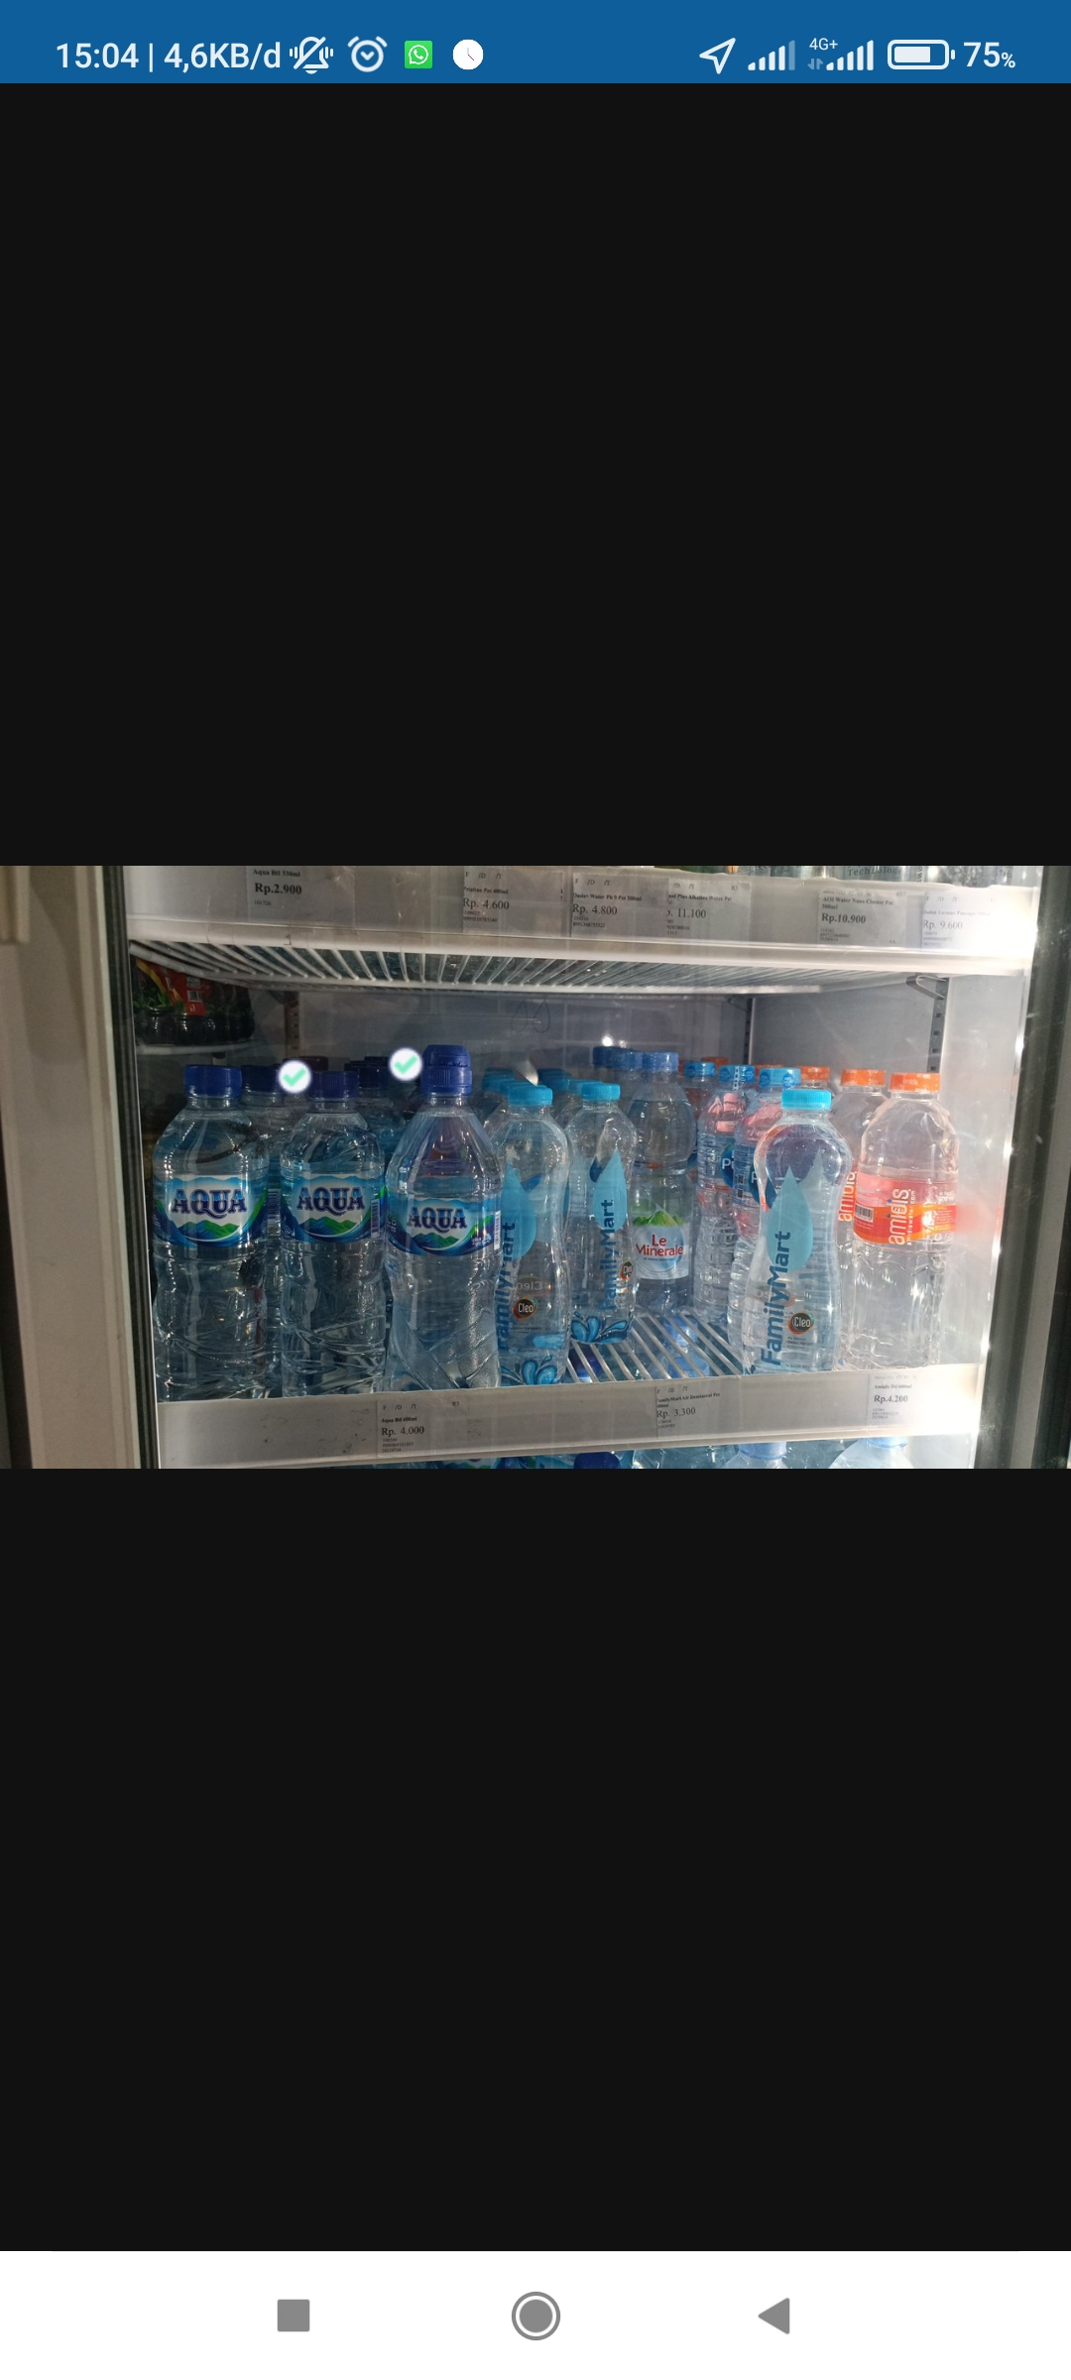
Dummy Store (Familymart) – Not Following Standard (Chiller)
RESULT :
1500ML AQUA LOCAL (product detected)
600ML AQUA LOCAL (detected)
1500ML VIT LOCAL (actual oos)
350ML LEVITE LEMON CUCUMBER MINT (actual oos)
350ML LEVITE LYCHEE CITRUS MITN (actual oos)
350ML LEVITE WILDBERRIES MINT (actual oos)
500ML MIZONE ACTIV LYCHEE LEMON (actual oos)
500ML MIZONE ACTIV MOOD UP CRANBERRY (actual oos)
500ML MIZONE ACTIV BREAKFREE CHERRYBLOSSOM (actual oos)
500ML MIZONE ACTIV MOVE ON STARFRUIT (actual oos)
350ML MIZONE ACTIV LYCHEE LEMON (actual oos)
550ML VIT LOCAL

Slide 4
Dummy Store (Familymart) – Not Following Standard (Regular)
No photo in Reguler Rack

Slide 5
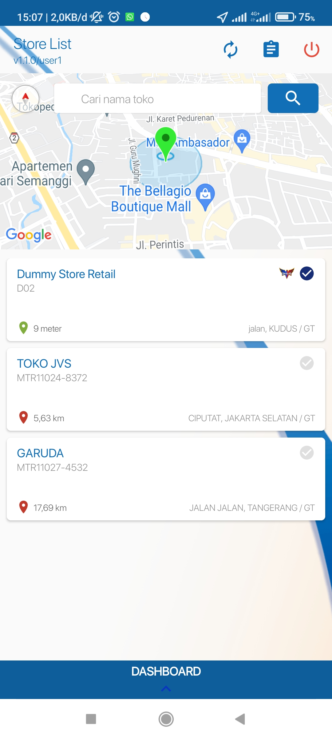
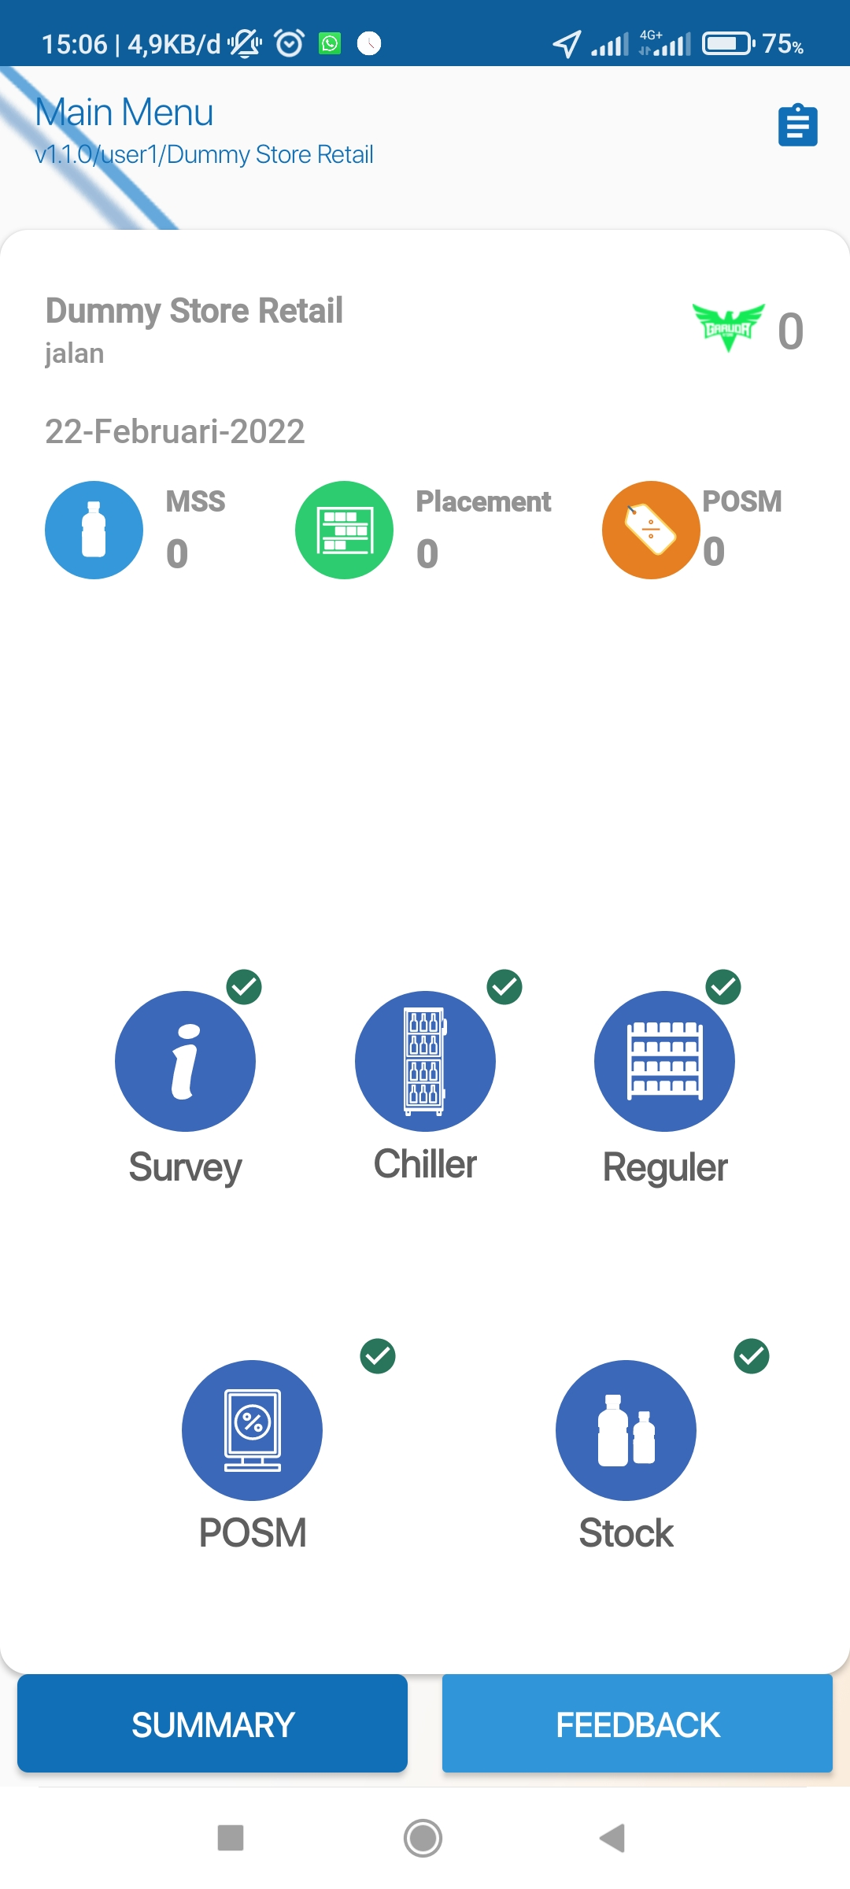
VISIT

Slide 6
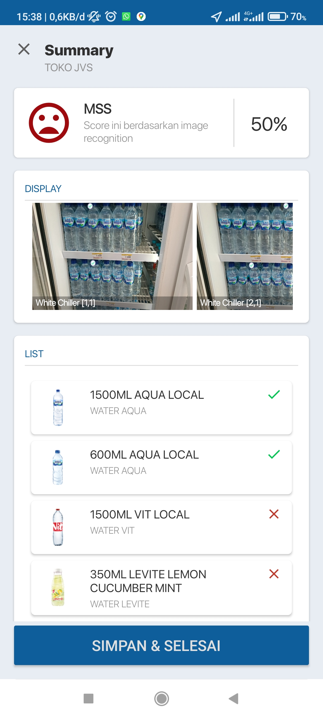
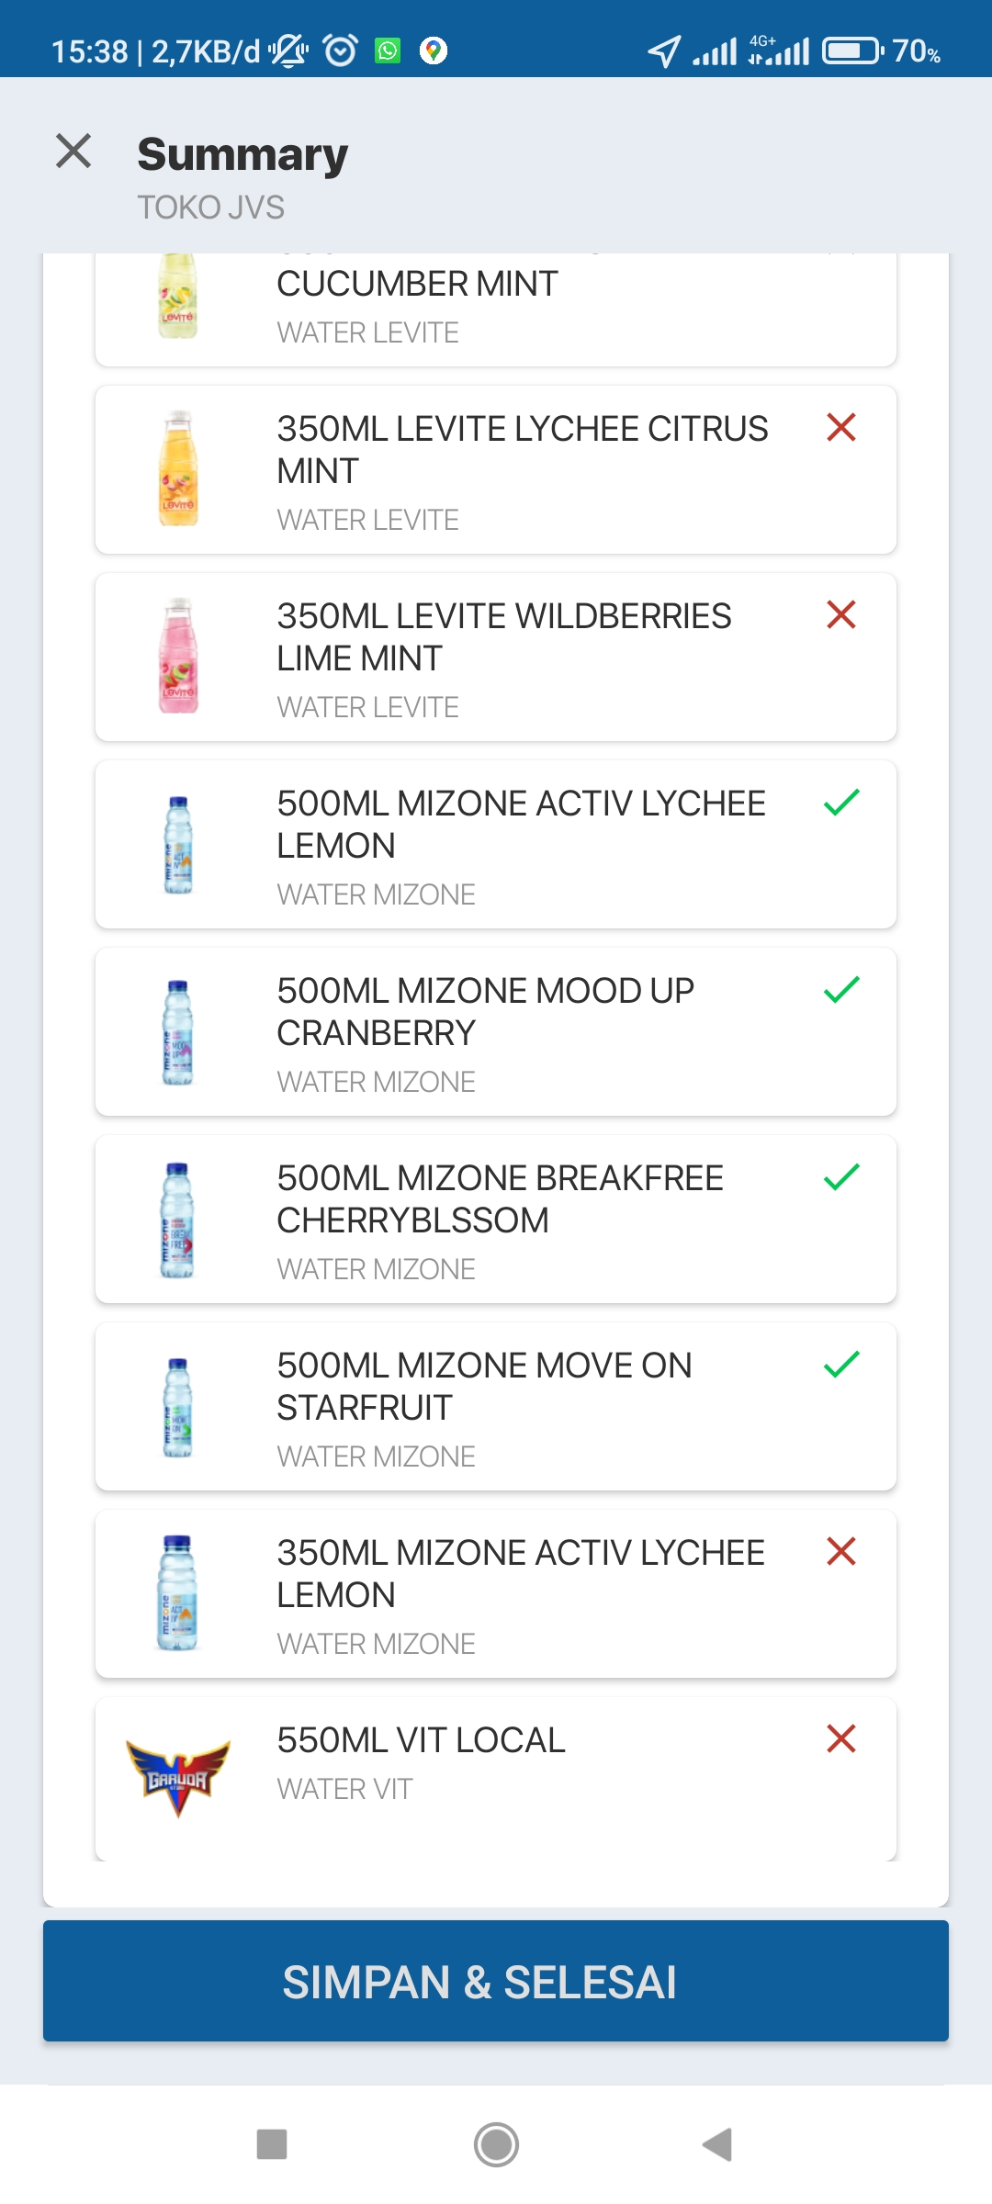
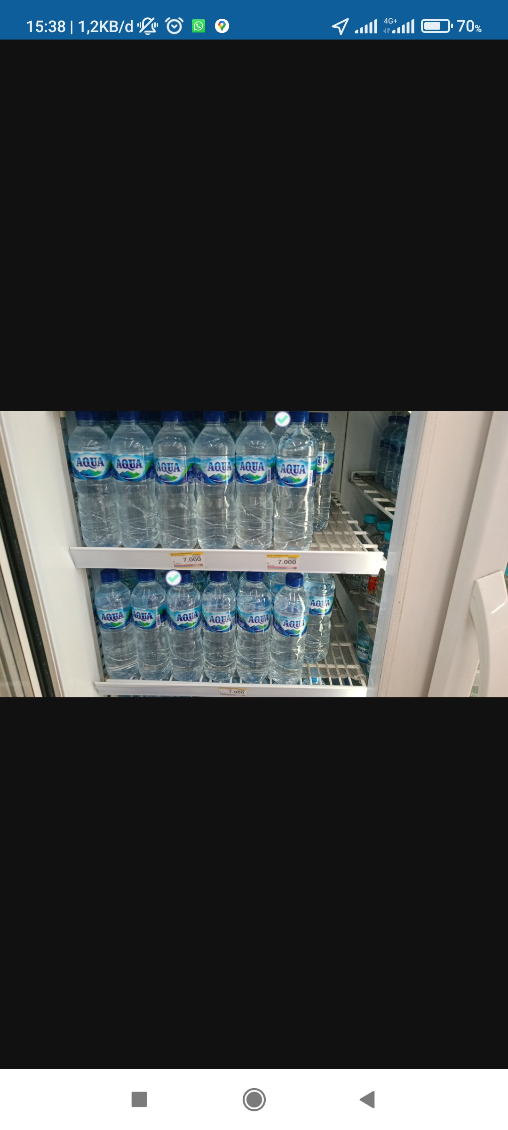
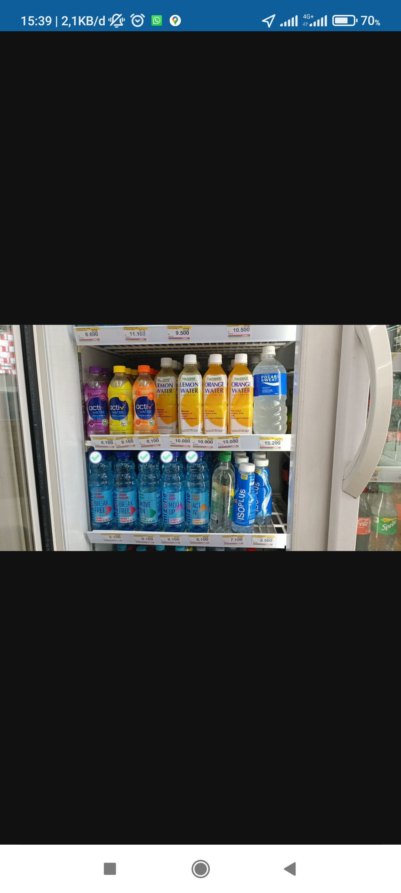
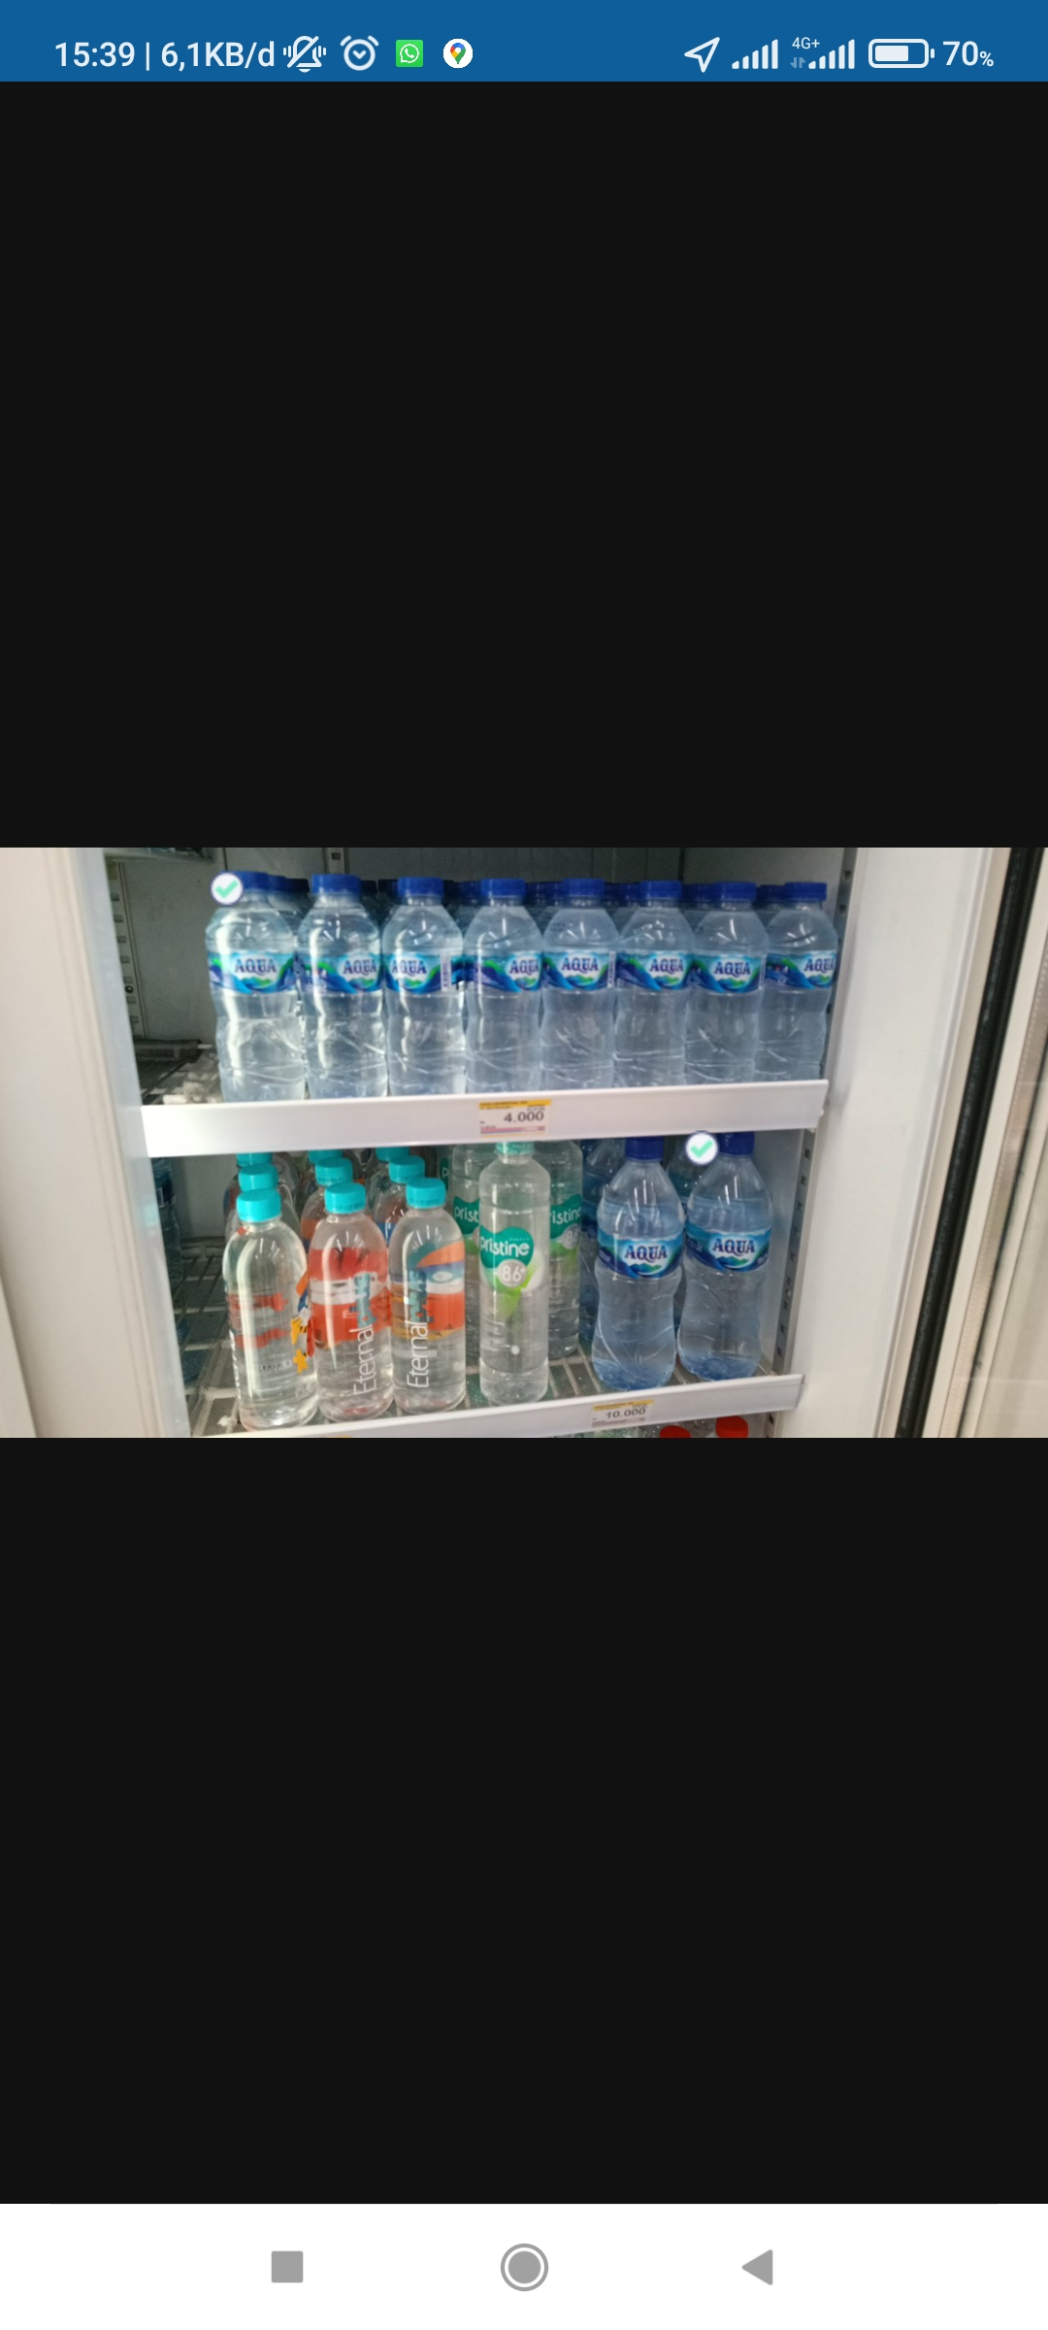
Toko JVS (Indomart) – Following Standard (Chiller)
RESULT :
1500ML AQUA LOCAL (actual oos)
600ML AQUA LOCAL (product detected)
1500ML VIT LOCAL (actual oos)
350ML LEVITE LEMON CUCUMBER MINT (actual oos)
350ML LEVITE LYCHEE CITRUS MITN (actual oos)
350ML LEVITE WILDBERRIES MINT (actual oos)
500ML MIZONE ACTIV LYCHEE LEMON (product detected)
500ML MIZONE ACTIV MOOD UP CRANBERRY (product detected)
500ML MIZONE ACTIV BREAKFREE CHERRYBLOSSOM (product detected)
500ML MIZONE ACTIV MOVE ON STARFRUIT (product detected)
350ML MIZONE ACTIV LYCHEE LEMON (actual oos)
550ML VIT LOCAL (actual oos)

Slide 7
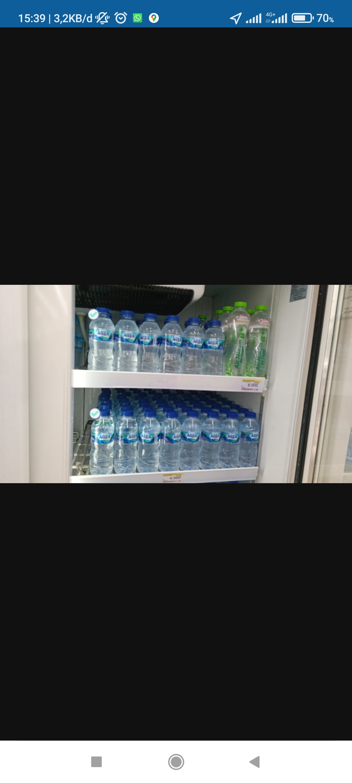

Toko JVS (Indomart) – Not Following Standard (Chiller)
RESULT :
1500ML AQUA LOCAL (actual oos)
600ML AQUA LOCAL (detected)
1500ML VIT LOCAL (actual oos)
350ML LEVITE LEMON CUCUMBER MINT (actual oos)
350ML LEVITE LYCHEE CITRUS MITN (actual oos)
350ML LEVITE WILDBERRIES MINT (actual oos)
500ML MIZONE ACTIV LYCHEE LEMON (product detected)
500ML MIZONE ACTIV MOOD UP CRANBERRY (product detected)
500ML MIZONE ACTIV BREAKFREE CHERRYBLOSSOM (product detected)
500ML MIZONE ACTIV MOVE ON STARFRUIT (product detected)
350ML MIZONE ACTIV LYCHEE LEMON (actual oos)
550ML VIT LOCAL (actual oos)

Slide 8
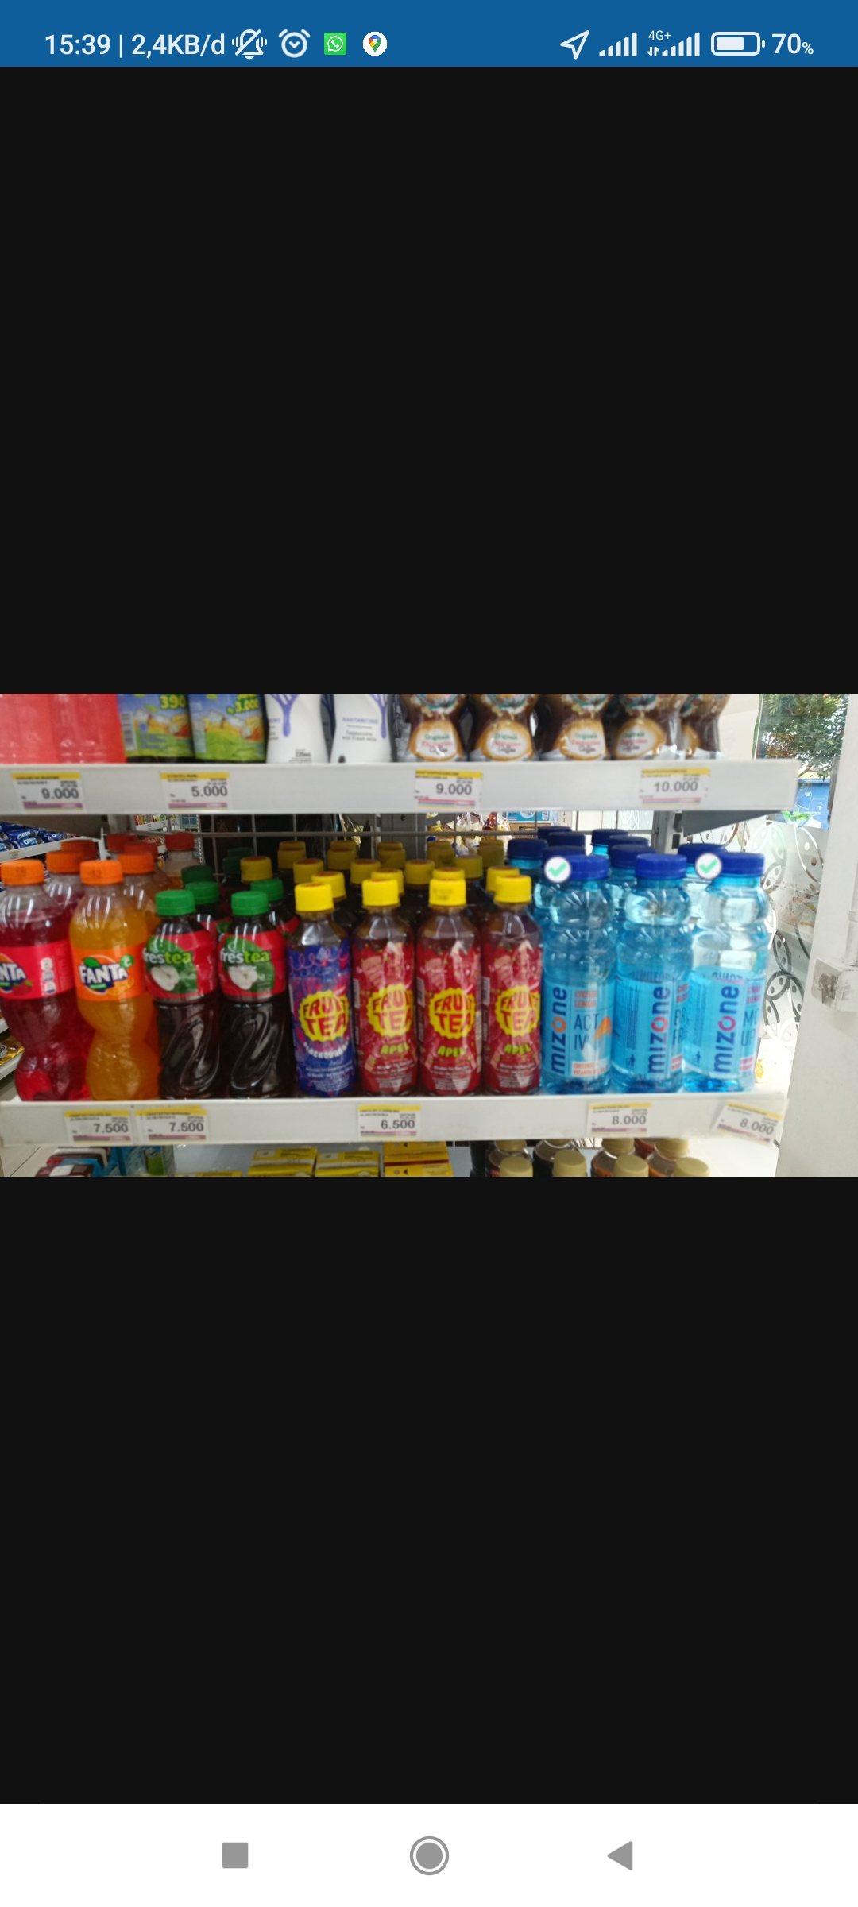
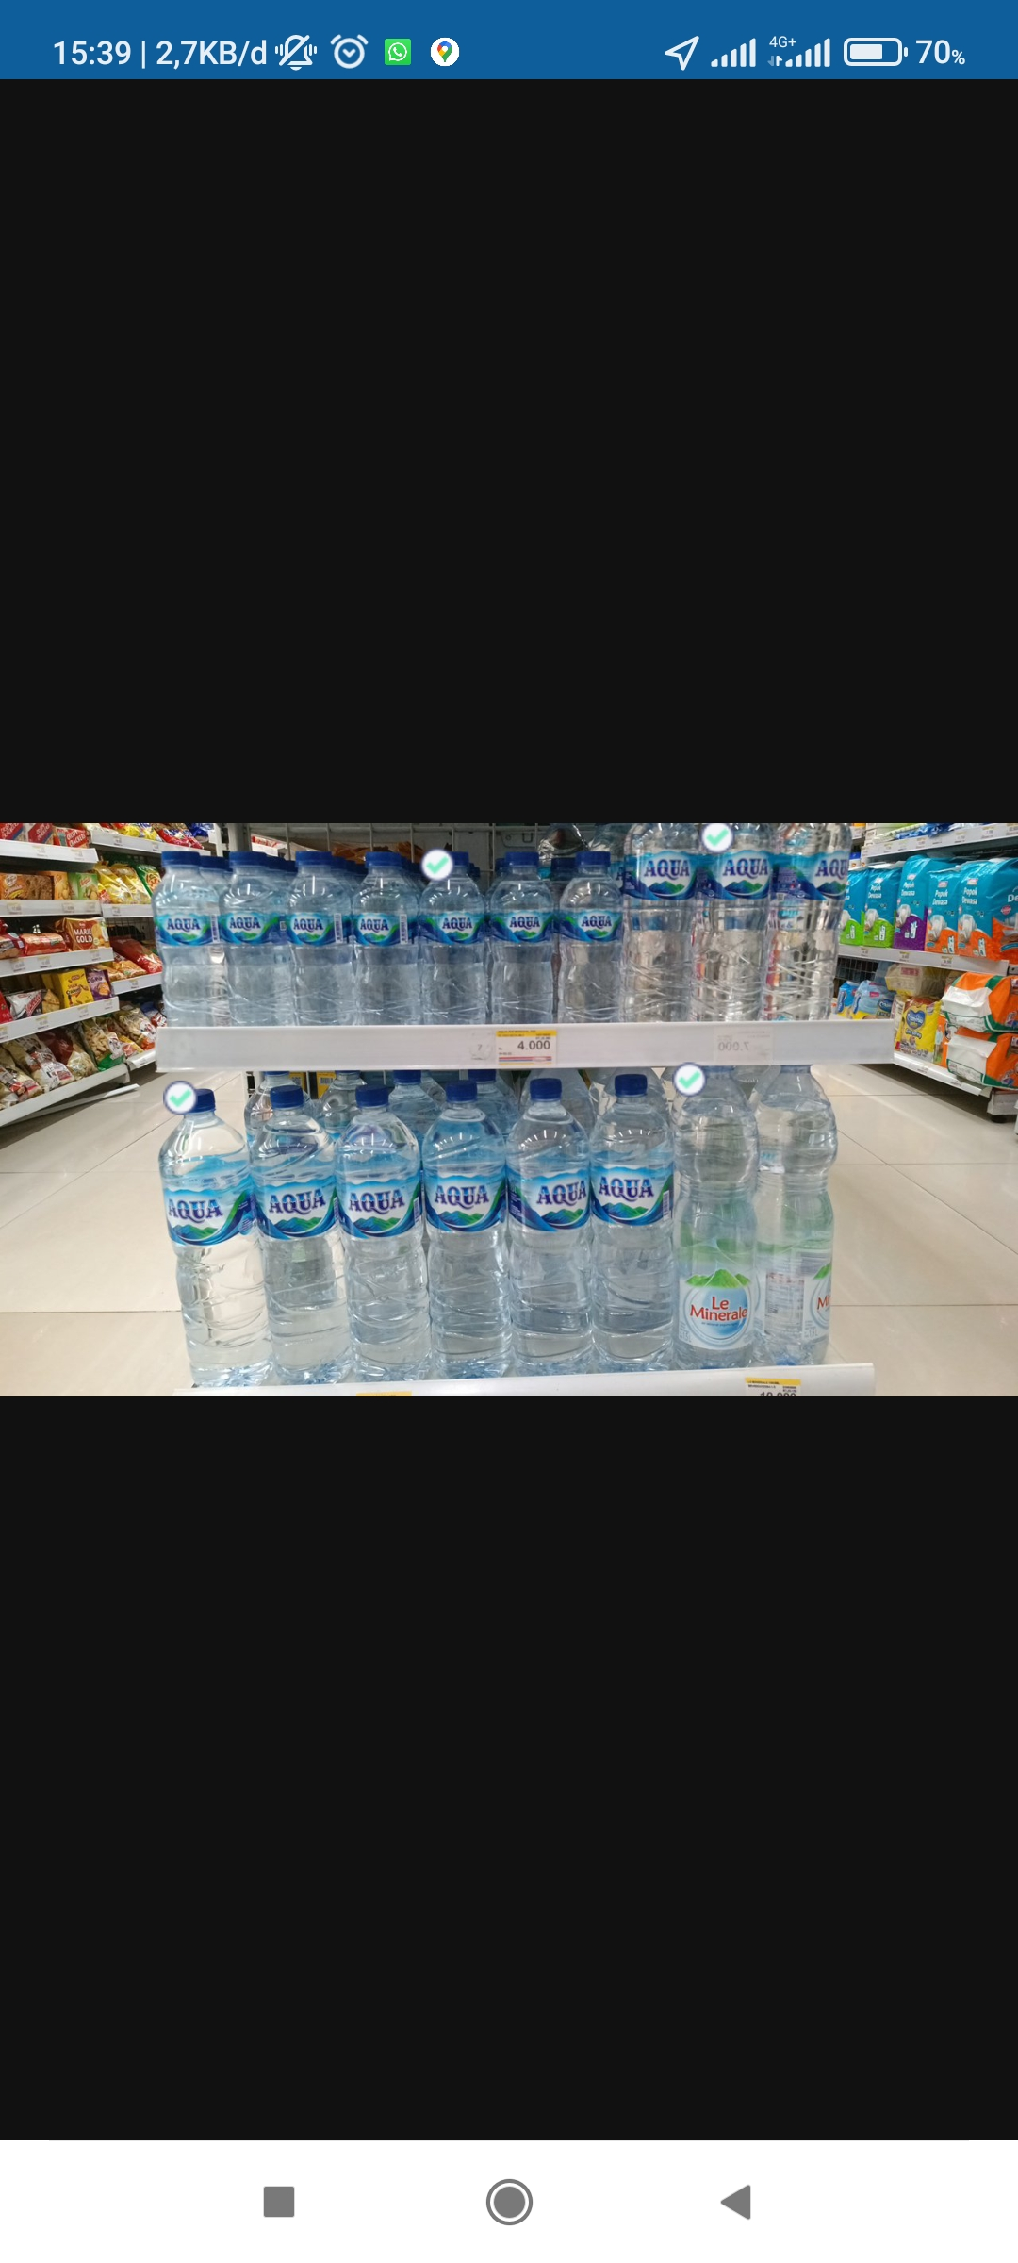
Toko JVS (Indomart) – Not Following Standard (Regular)
RESULT :
1500ML AQUA LOCAL (product detected)
600ML AQUA LOCAL (detected)
1500ML VIT LOCAL (actual oos)
350ML LEVITE LEMON CUCUMBER MINT (actual oos)
350ML LEVITE LYCHEE CITRUS MITN (actual oos)
350ML LEVITE WILDBERRIES MINT (actual oos)
500ML MIZONE ACTIV LYCHEE LEMON (detected)
500ML MIZONE ACTIV MOOD UP CRANBERRY (detected)
500ML MIZONE ACTIV BREAKFREE CHERRYBLOSSOM (not detected in photo)
500ML MIZONE ACTIV MOVE ON STARFRUIT (actual oos)
350ML MIZONE ACTIV LYCHEE LEMON (actual oos)
550ML VIT LOCAL

Slide 9
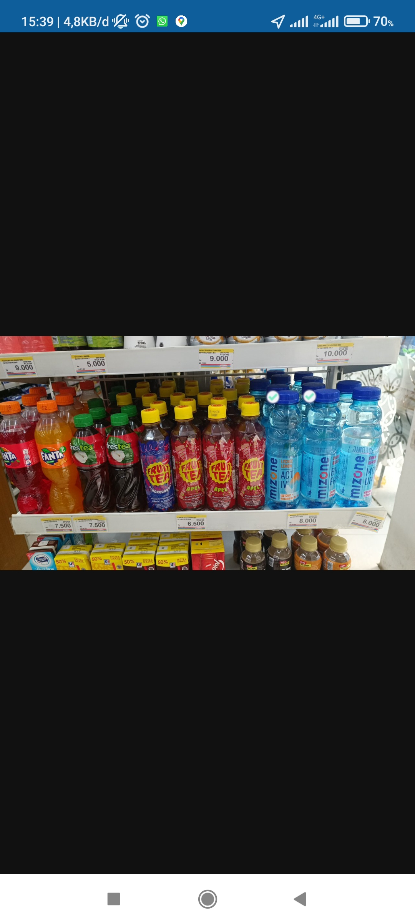
Toko JVS (Indomart) – Following Standard (Regular)
RESULT :
1500ML AQUA LOCAL (product detected)
600ML AQUA LOCAL (detected)
1500ML VIT LOCAL (actual oos)
350ML LEVITE LEMON CUCUMBER MINT (actual oos)
350ML LEVITE LYCHEE CITRUS MITN (actual oos)
350ML LEVITE WILDBERRIES MINT (actual oos)
500ML MIZONE ACTIV LYCHEE LEMON (detected)
500ML MIZONE ACTIV MOOD UP CRANBERRY (not detected in photo)
500ML MIZONE ACTIV BREAKFREE CHERRYBLOSSOM (detected)
500ML MIZONE ACTIV MOVE ON STARFRUIT (actual oos)
350ML MIZONE ACTIV LYCHEE LEMON (actual oos)
550ML VIT LOCAL

Slide 10
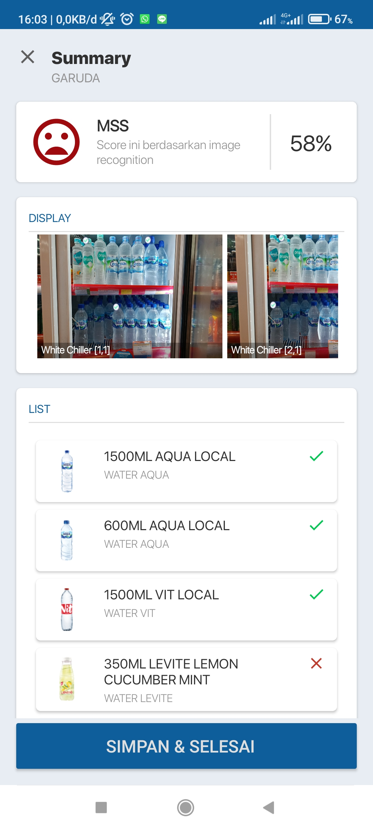
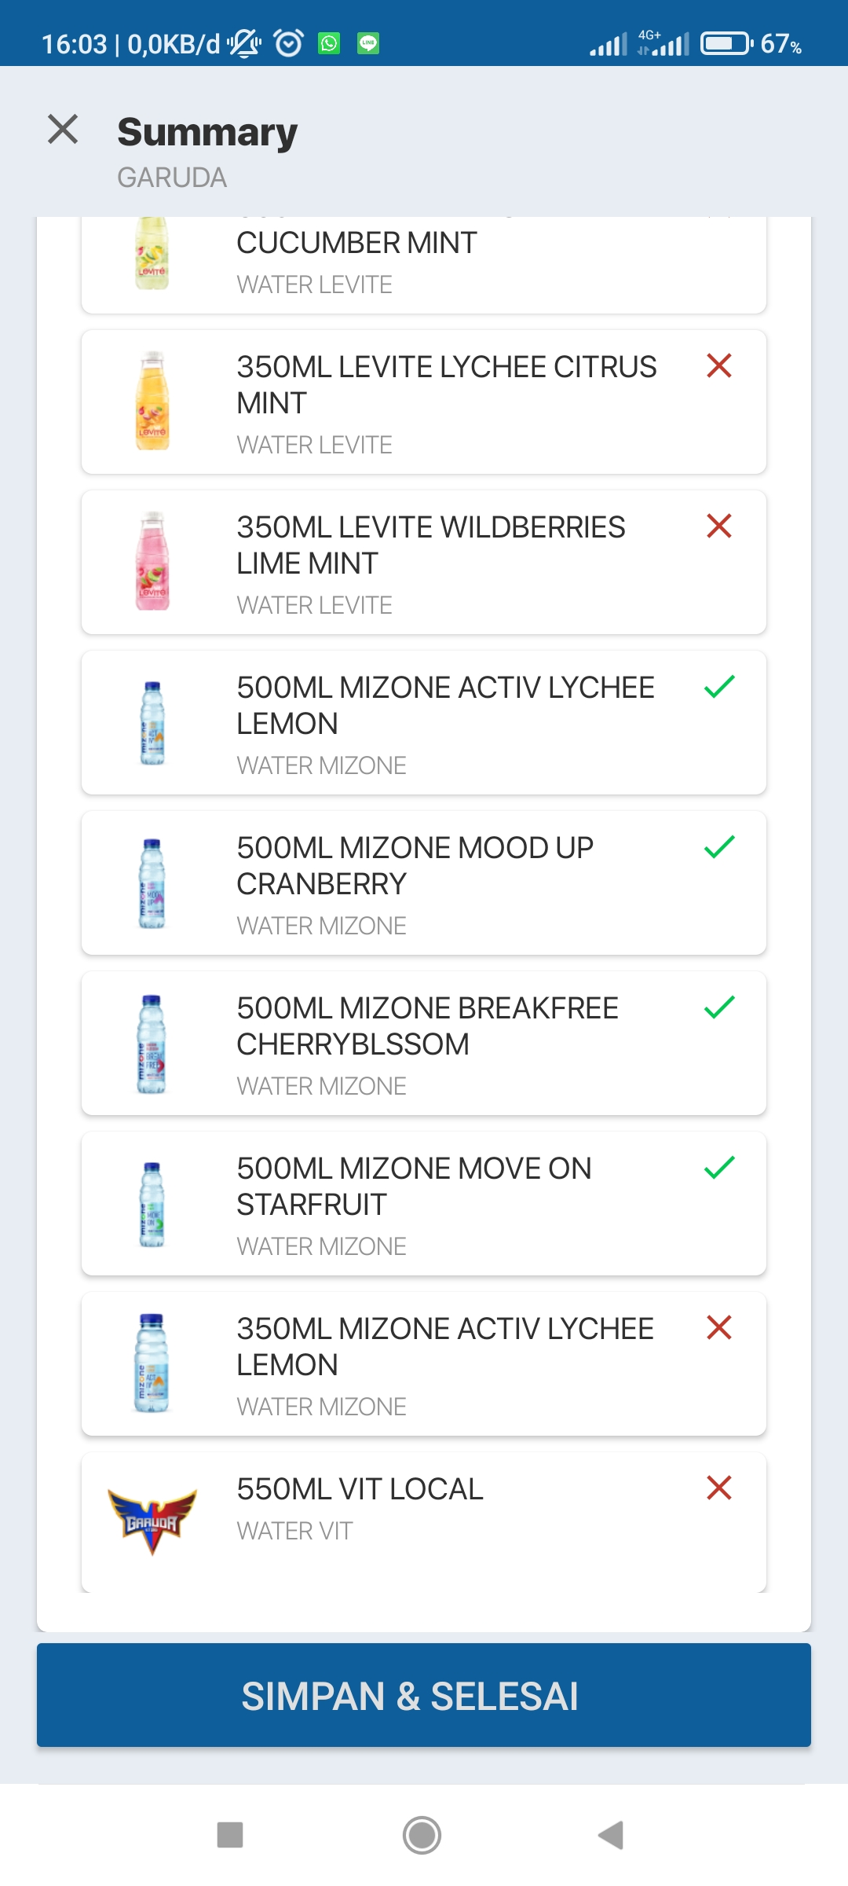
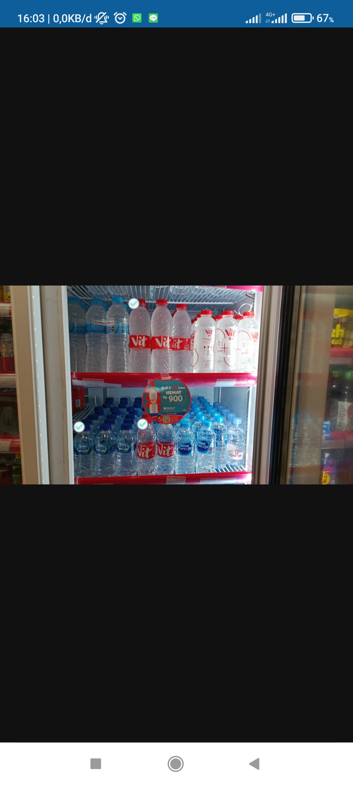
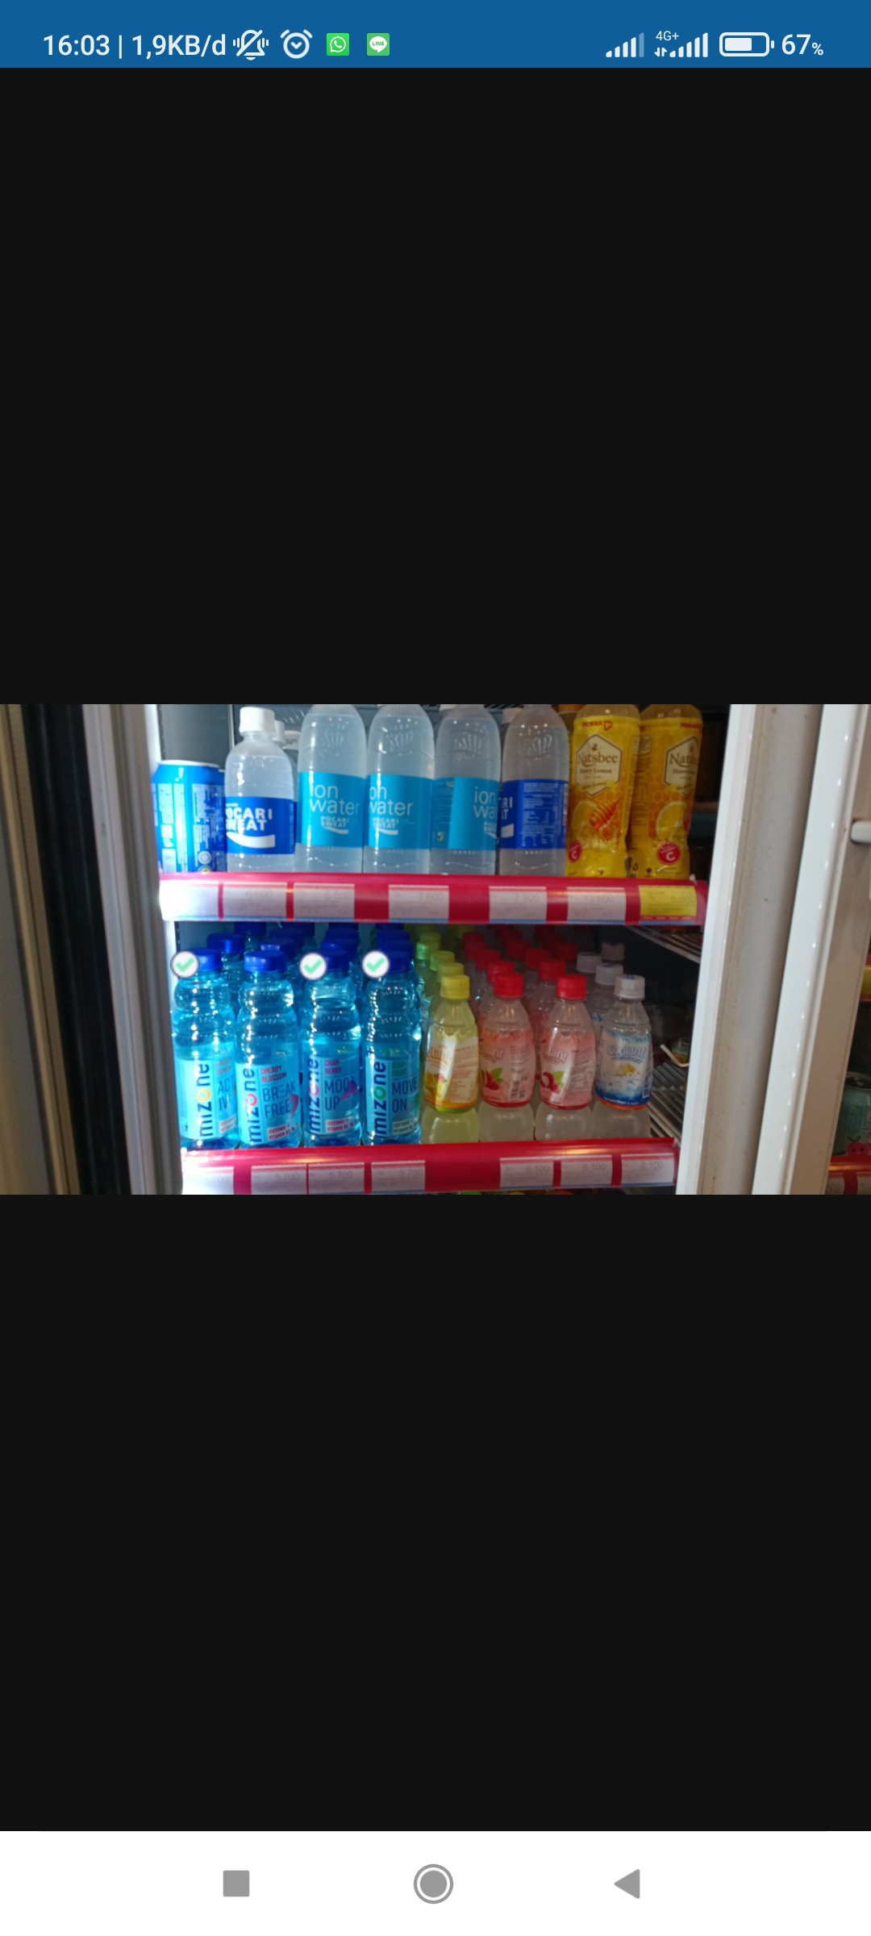
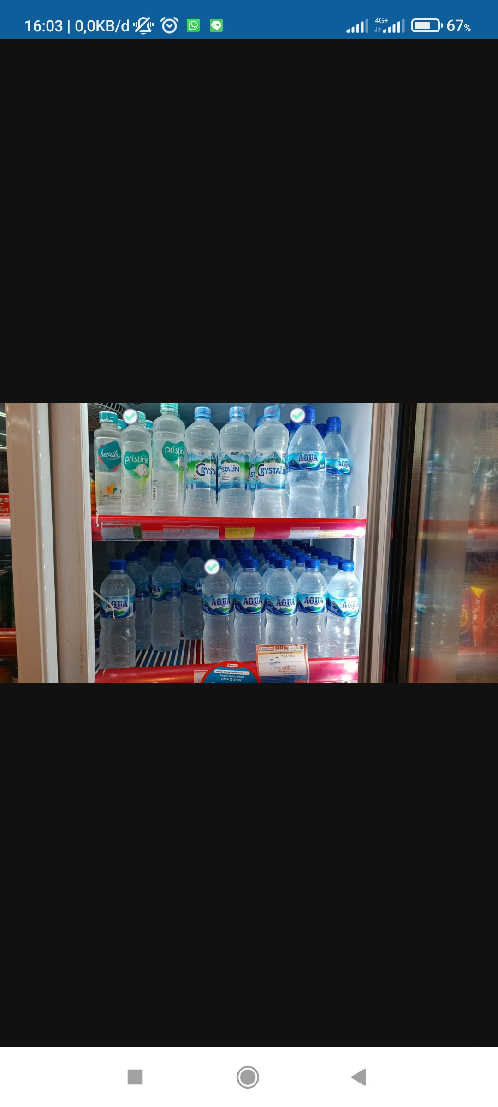
Garuda (Alfamart) – Not Following Standard (Chiller)
RESULT :
1500ML AQUA LOCAL (actual oos)
600ML AQUA LOCAL (detected)
1500ML VIT LOCAL (actual oos)
350ML LEVITE LEMON CUCUMBER MINT (actual oos)
350ML LEVITE LYCHEE CITRUS MITN (actual oos)
350ML LEVITE WILDBERRIES MINT (actual oos)
500ML MIZONE ACTIV LYCHEE LEMON (detected)
500ML MIZONE ACTIV MOOD UP CRANBERRY (detected)
500ML MIZONE ACTIV BREAKFREE CHERRYBLOSSOM (not detected in photo)
500ML MIZONE ACTIV MOVE ON STARFRUIT (detected)
350ML MIZONE ACTIV LYCHEE LEMON (actual oos)
550ML VIT LOCAL (actual oos)

Slide 11
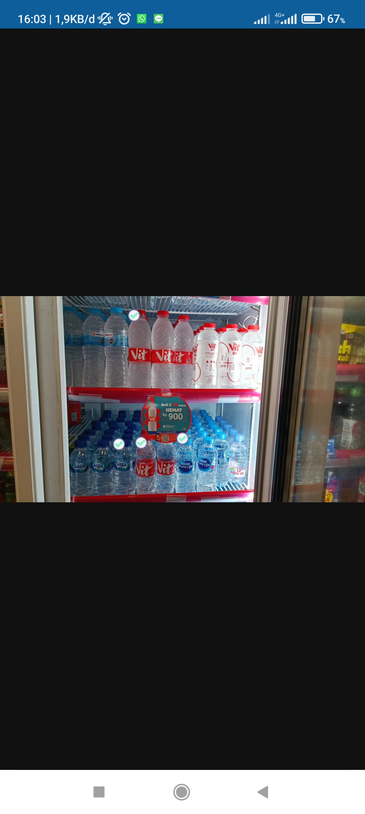
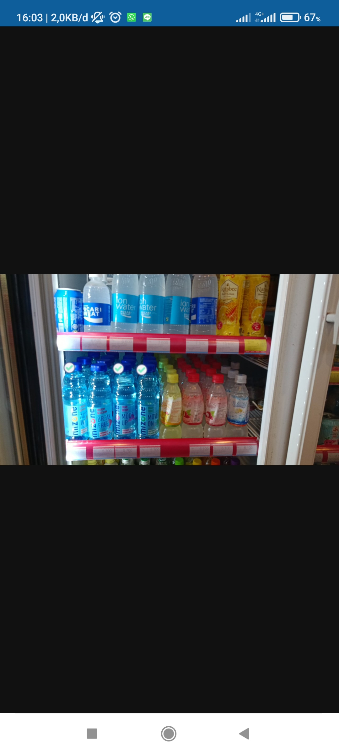
Garuda (Alfamart) – Following Standard (Chiller)
RESULT :
1500ML AQUA LOCAL (product detected)
600ML AQUA LOCAL (detected)
1500ML VIT LOCAL (actual oos)
350ML LEVITE LEMON CUCUMBER MINT (actual oos)
350ML LEVITE LYCHEE CITRUS MITN (actual oos)
350ML LEVITE WILDBERRIES MINT (actual oos)
500ML MIZONE ACTIV LYCHEE LEMON (detected)
500ML MIZONE ACTIV MOOD UP CRANBERRY (detected)
500ML MIZONE ACTIV BREAKFREE CHERRYBLOSSOM (not detected)
500ML MIZONE ACTIV MOVE ON STARFRUIT (actual oos)
350ML MIZONE ACTIV LYCHEE LEMON (actual oos)
550ML VIT LOCAL

Slide 12
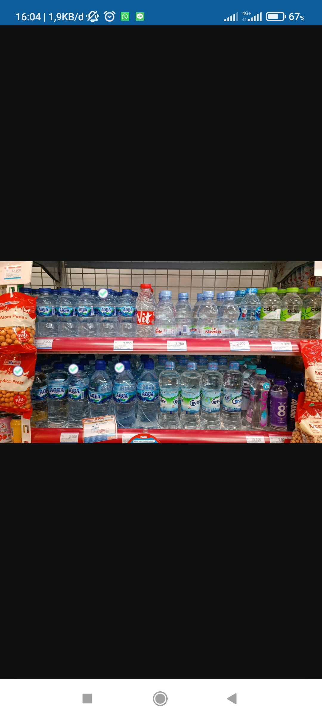
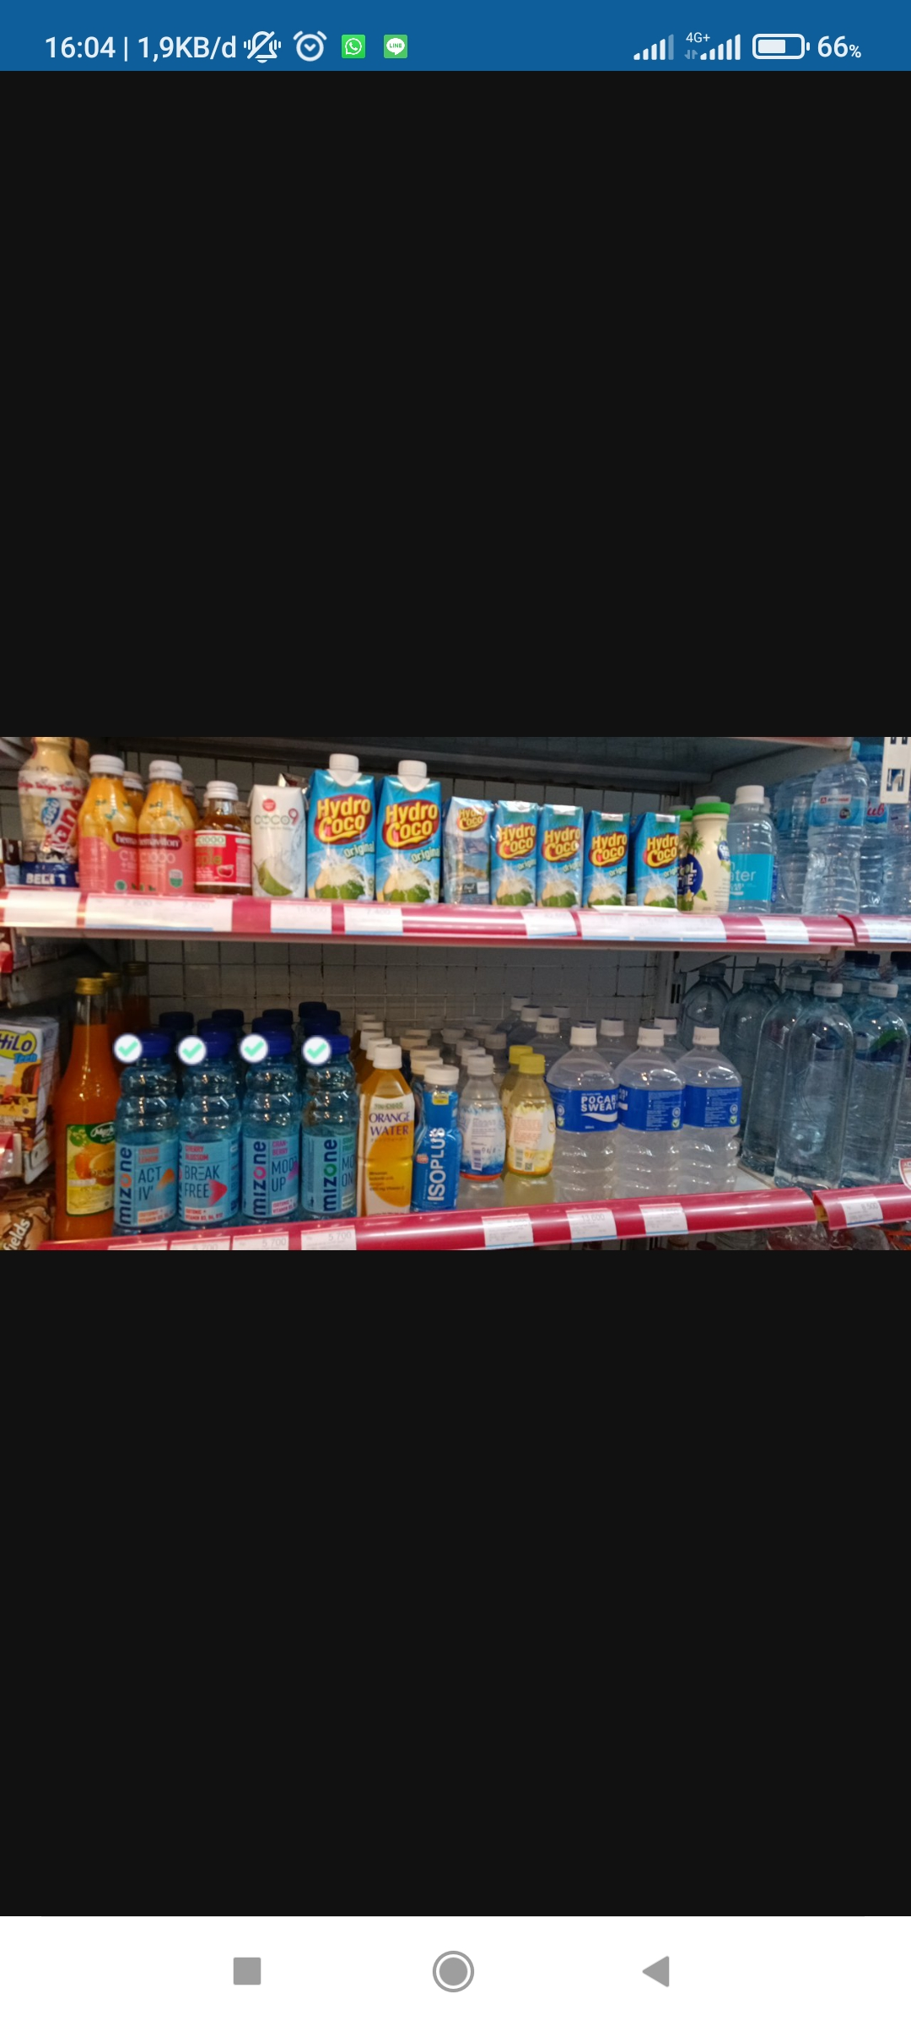
Garuda (Alfamart) – Following Standard (Regular)
RESULT :
1500ML AQUA LOCAL (product detected)
600ML AQUA LOCAL (detected)
1500ML VIT LOCAL (actual oos)
350ML LEVITE LEMON CUCUMBER MINT (actual oos)
350ML LEVITE LYCHEE CITRUS MITN (actual oos)
350ML LEVITE WILDBERRIES MINT (actual oos)
500ML MIZONE ACTIV LYCHEE LEMON (detected)
500ML MIZONE ACTIV MOOD UP CRANBERRY (detected)
500ML MIZONE ACTIV BREAKFREE CHERRYBLOSSOM (detected)
500ML MIZONE ACTIV MOVE ON STARFRUIT (detected)
350ML MIZONE ACTIV LYCHEE LEMON (actual oos)
550ML VIT LOCAL (actual oos)

Slide 13
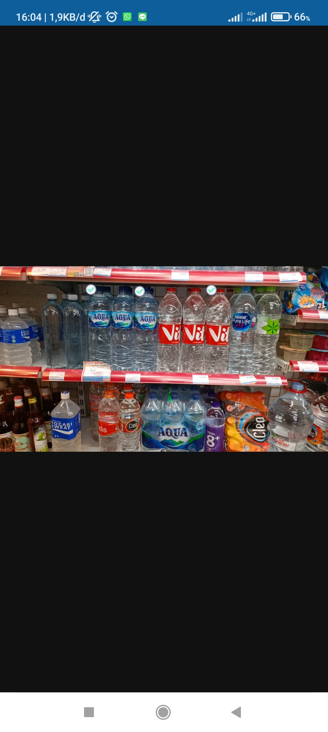
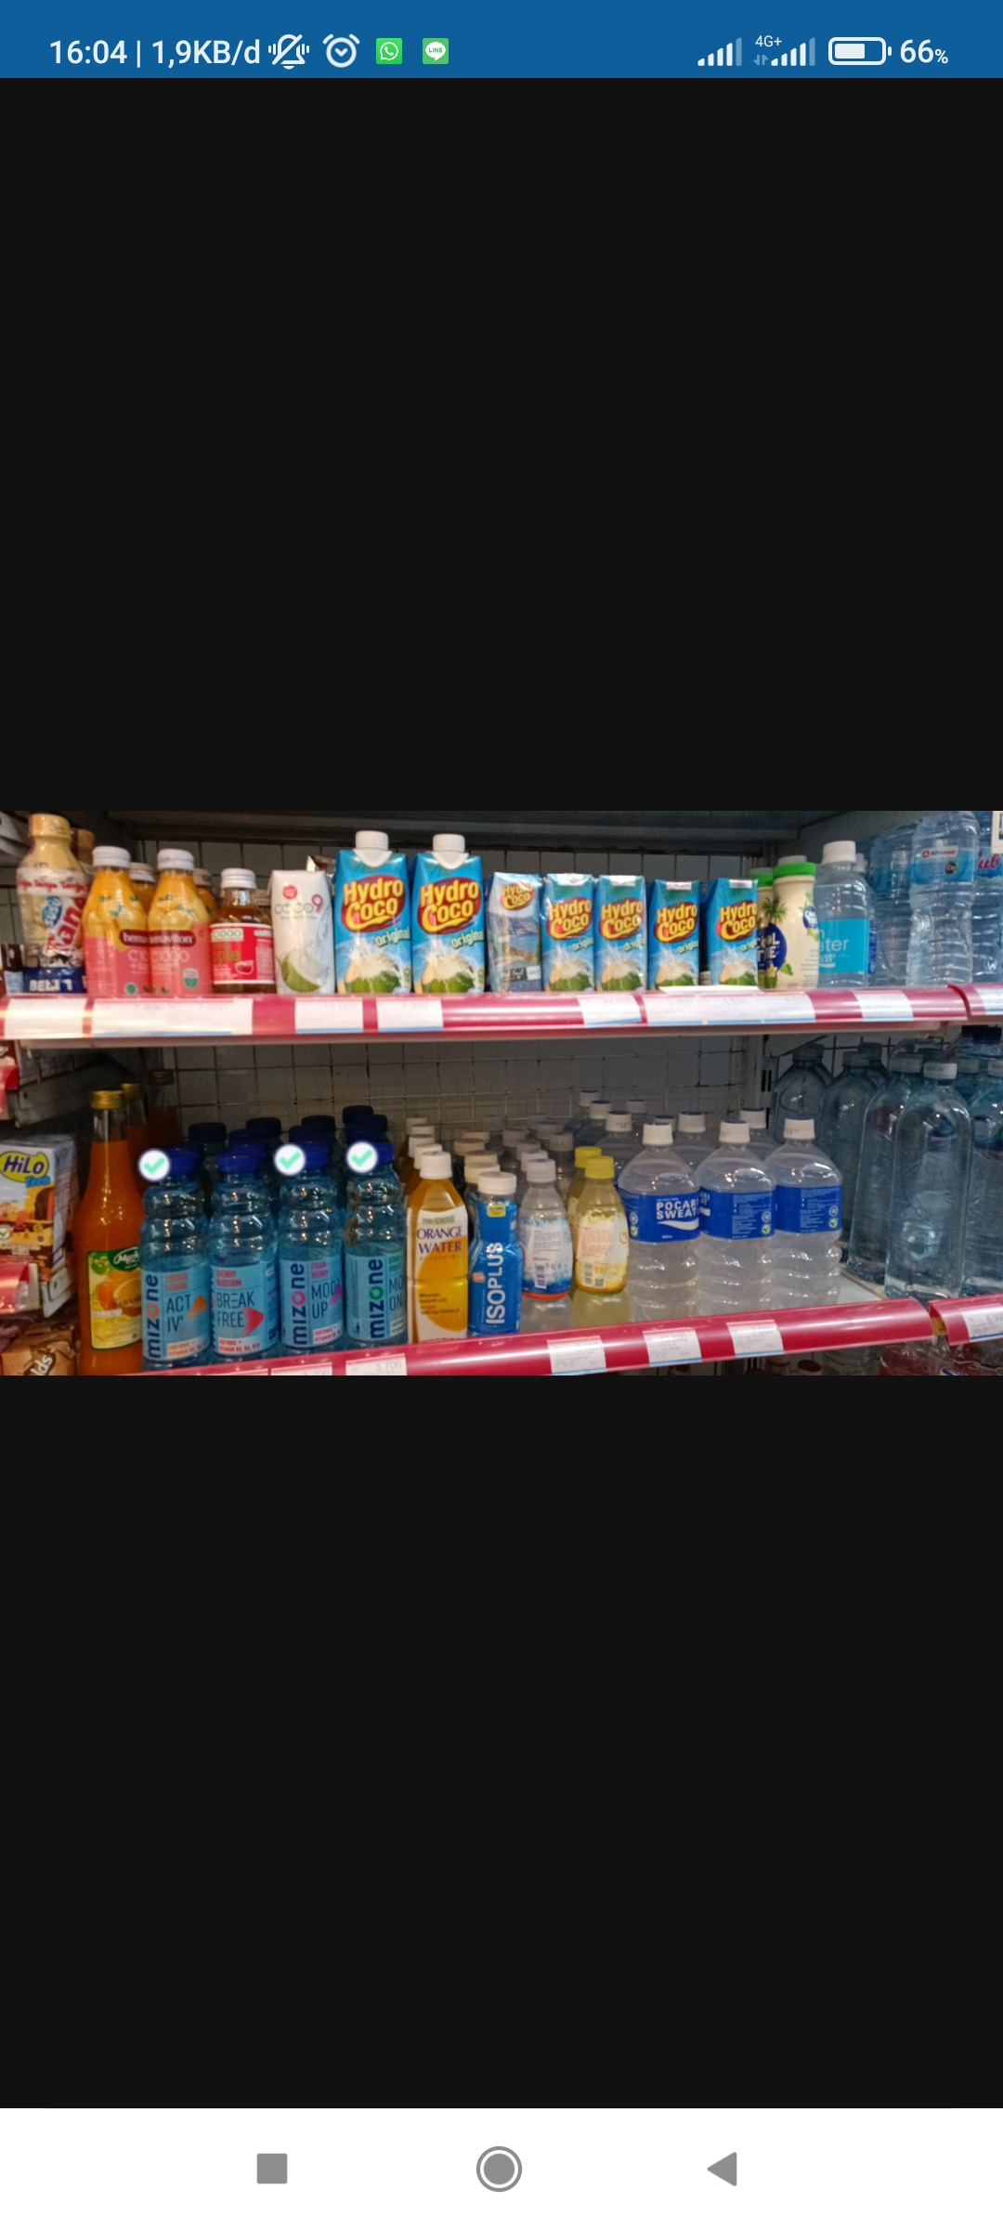
Garuda (Alfamart) – Following Standard (Regular)
RESULT :
1500ML AQUA LOCAL (product detected)
600ML AQUA LOCAL (detected)
1500ML VIT LOCAL (product detected)
350ML LEVITE LEMON CUCUMBER MINT (actual oos)
350ML LEVITE LYCHEE CITRUS MITN (actual oos)
350ML LEVITE WILDBERRIES MINT (actual oos)
500ML MIZONE ACTIV LYCHEE LEMON (detected)
500ML MIZONE ACTIV MOOD UP CRANBERRY (detected)
500ML MIZONE ACTIV BREAKFREE CHERRYBLOSSOM (not detected in photo)
500ML MIZONE ACTIV MOVE ON STARFRUIT (detected)
350ML MIZONE ACTIV LYCHEE LEMON (actual oos)
550ML VIT LOCAL (actual oos)

Slide 14

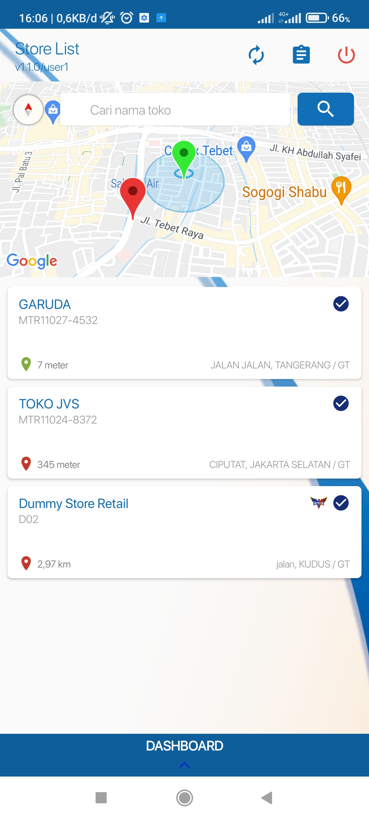
VISIT

